Slide 1
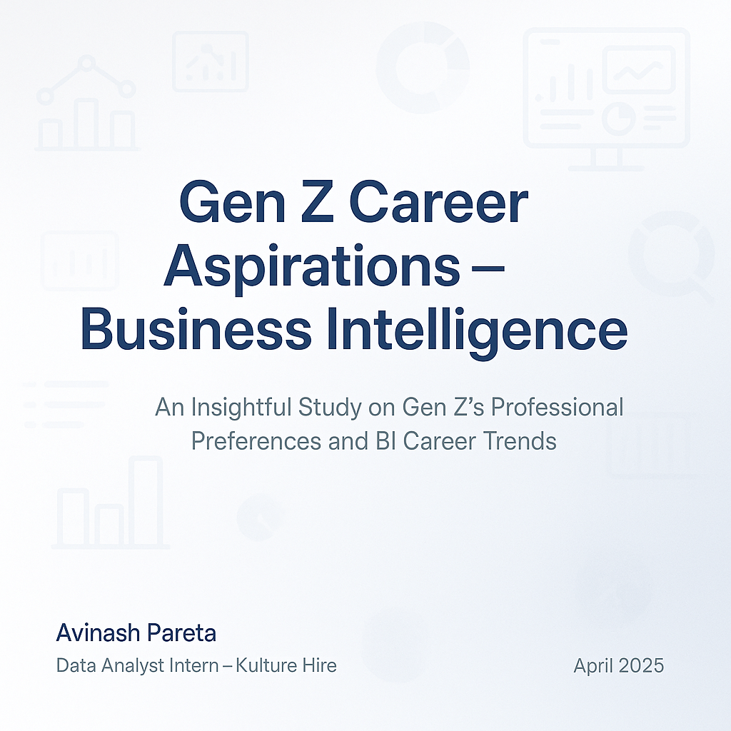

Slide 2
ROADMAP
1
Problem Statement
Understanding the Career Aspirations of Gen Z and Bridging the Expectation Gap with Employers
2
Impact
Stakeholders Affected by Gen Z’s Lack of Understanding of Career Aspirations
3
Data Collection
Created a Google Form with tailored questions to collect data on Gen-Z's career aspirations.
4
Dashboard
Develop Excel Dashboard Analyzing Gen Z Work Aspiration
5
Analysis In MySQL
Run Basic Queries
6
Power BI Dashboard
Creating Focused Multipage Dashboard for Work Alignment, Managerial Preferences of Gen Z, Career Path & Education Goals.
7
Presentation
Worked on an employer-focused project, creating recommendations and emphasizing the importance of storytelling in data.

Slide 3
Problem Statement in 5W Format

Slide 4
WHAT & WHY
What is happening
Understanding the career aspirations of Gen Z is essential in today’s evolving workforce. This generation, known for their digital fluency, values alignment with purpose, flexibility, and work-life balance. However, there's often a disconnect between what they seek and what employers offer. This gap affects job satisfaction, performance, and retention. The objective is to identify these aspirations and bridge the gap between expectations and the reality offered by organizations. The study explores Gen Z's vision for their future careers, including preferred job roles, work environments, and expectations from leadership and learning opportunities.
WHY is happening:
Bridging the expectation gap is critical for both employers and Gen Z talent. Misalignment leads to disengagement, increased attrition, and underperformance. Companies investing in understanding Gen Z can tailor roles, benefits, and development paths, leading to improved morale and productivity. Gen Z, on the other hand, gains clarity about their career direction and the skills needed. This two-way understanding helps build a more inclusive and sustainable work culture, reducing hiring friction and boosting long-term retention and innovation.

Slide 5
WHO, WHERE, WHEN
WHO is affected:
The primary stakeholders affected by this issue include Gen Z professionals entering the job market, HR teams, learning & development departments, and senior managers. Gen Z, aged between 18-28, are at the center, while HR and L&D professionals face the challenge of designing effective onboarding and career paths. Employers must also adjust management styles to meet Gen Z’s unique values and work ethics.
WHERE is happening:
This issue spans across geographies but is most prominent in urban and digitally-forward workplaces, especially in sectors like IT, marketing, consulting, and education. Remote and hybrid environments have further diversified the dynamics of career expectations.
WHEN is happening:
The need to address this gap is immediate. As Gen Z forms an increasing portion of the workforce, the earlier these gaps are bridged, the better. Early intervention ensures smoother integration into organizations and supports leadership pipelines.

Slide 6
Reflections & Sources
Personal Thoughts:
Understanding Gen Z is not just about data; it’s about empathy. As a young professional myself, I relate to the desire for growth, meaningful work, and balance.
This project allowed me to explore how personal aspirations can align with professional structures. It strengthened my belief that career planning must be mutual – where both employee and employer benefit. It also opened my eyes to the fact that leadership isn’t just about authority but about being receptive, inclusive, and adaptive.
This generation is ready to innovate and challenge traditional norms, and organizations must create space for that energy to thrive.
Sources:
- Deloitte Gen Z and Millennial Survey 2023
- LinkedIn Workplace Learning Report 2023
- Harvard Business Review: Gen Z in the Workplace
- Pew Research Center: Gen Z Insights
- McKinsey: What Gen Z Wants from Work
- Survey responses collected through Google Forms

Slide 7
DATA COLLECTION

Slide 8
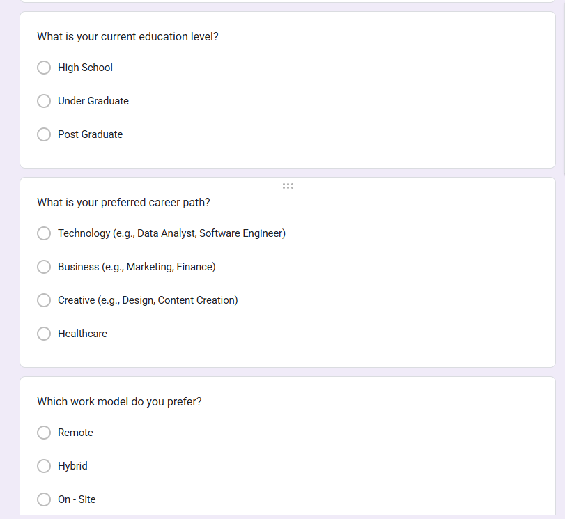
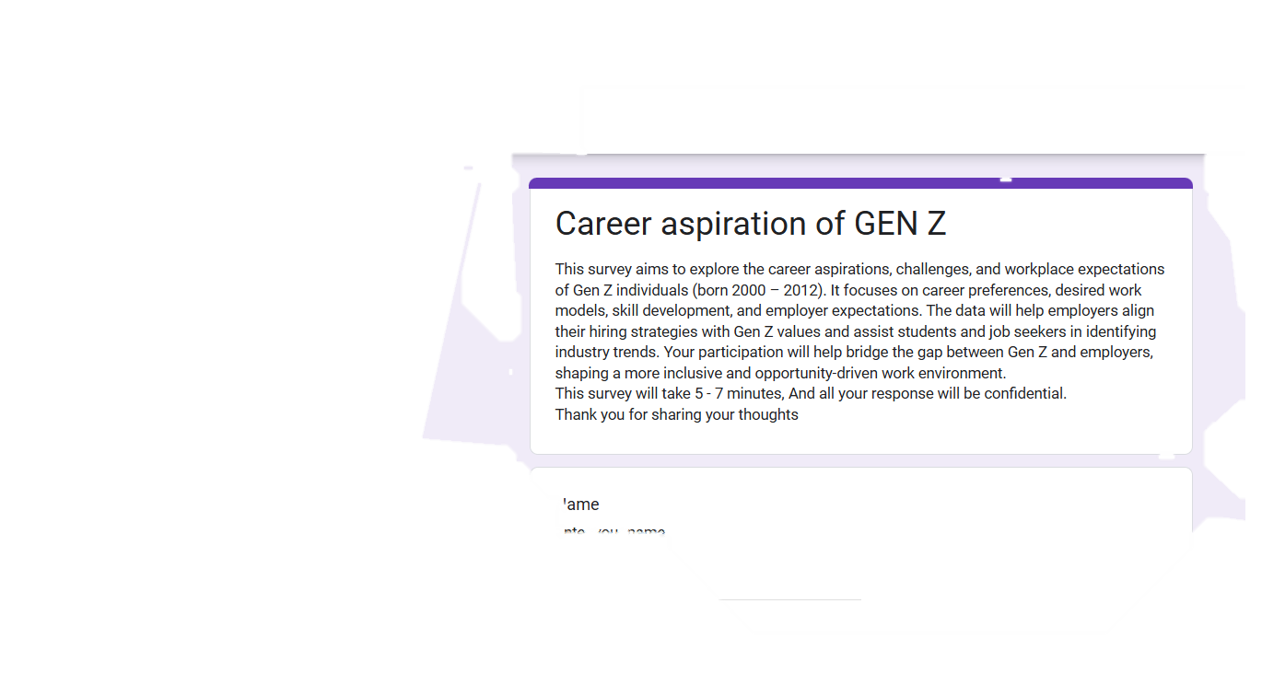

Slide 9
BASIC CLEANING AND STANDARDIZING IN EXCEL

Slide 10
WHAT I DID
Remove columns that are not needed for analysis.
Remove duplicate rows to avoid data redundancy.
Handle missing or null values by replacing or removing them.
Trim spaces and clean text to remove unnecessary characters.
Rename columns with meaningful and consistent names.
Change data types appropriately for each column.
Split columns by delimiter to separate values (e.g., Work Preference, Type of company).
Format text to lowercase, uppercase, or capitalize each word.
Remove rows with errors that may affect data integrity.
Filter out irrelevant or unnecessary rows.
Sort data to organize it meaningfully.
Load the cleaned and transformed data into the Excel.

Slide 11
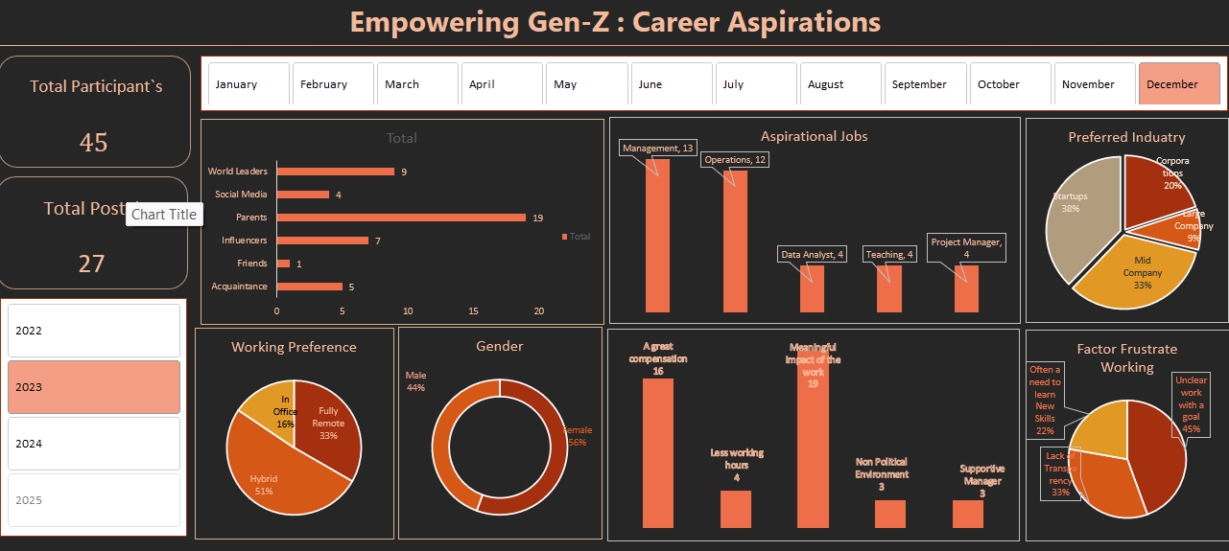

Slide 12
BASIC ANALYSIS IN MySQL

Slide 13
What are the total number of respondents.
2. Calculate Gender-wise distribution.
3. What are the Top factors influencing career aspirations.
4. How many are willing to do(Yes) higher education.
5. How many willingness to work for a company with an unclear mission.
6. How many willingness to work for a misaligned mission company.
7. What are top things that make them motivated at work.
8. Most preferred company size.
9. Which industry Gen Z wants to work in.

Slide 14
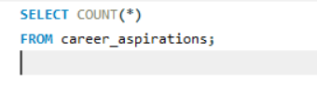

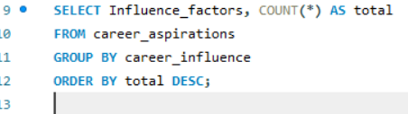
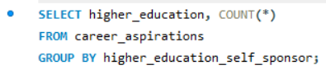
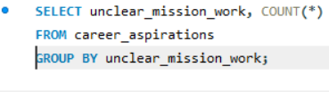
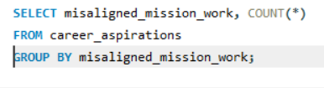

Slide 15
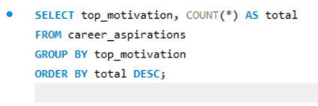
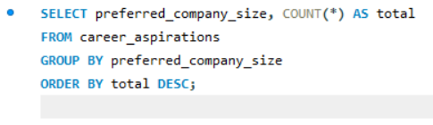
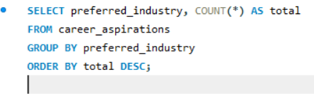

Slide 16
FOCUSED POWER BI DASHBOARD

Slide 17
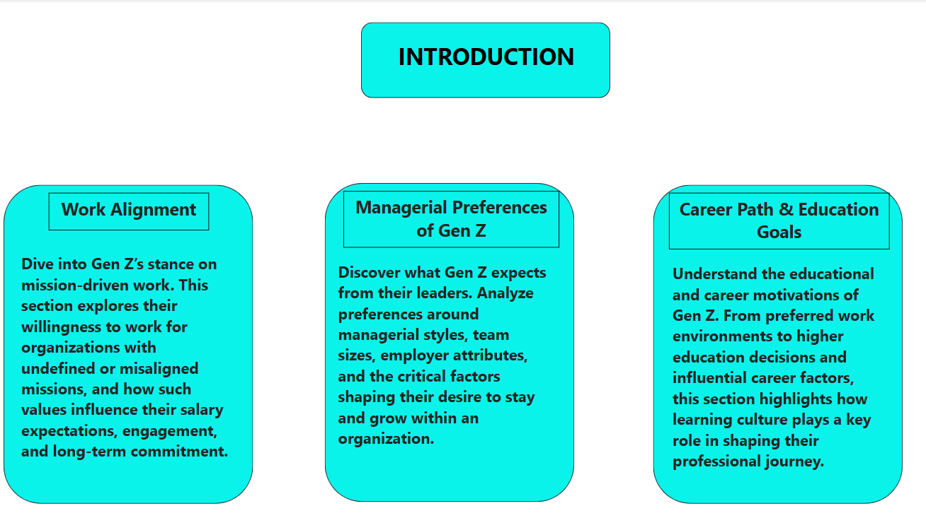

Slide 18
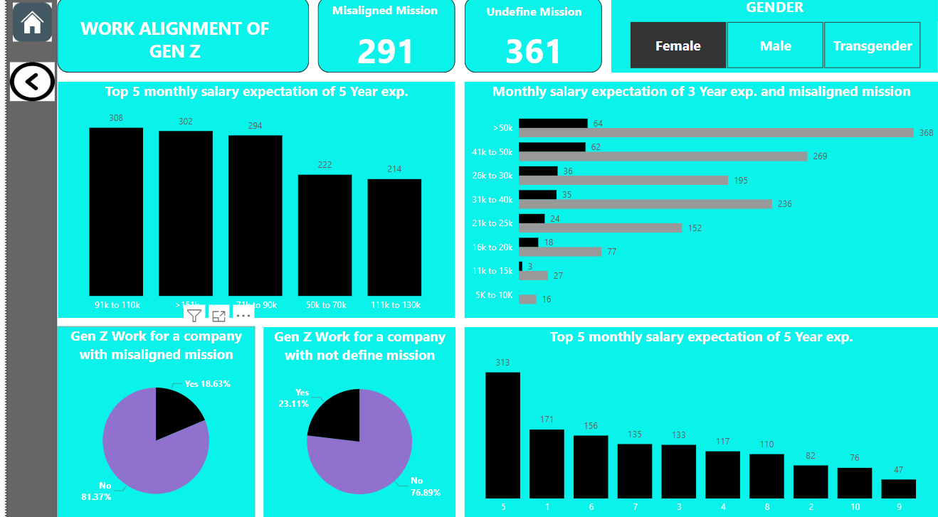

Slide 19
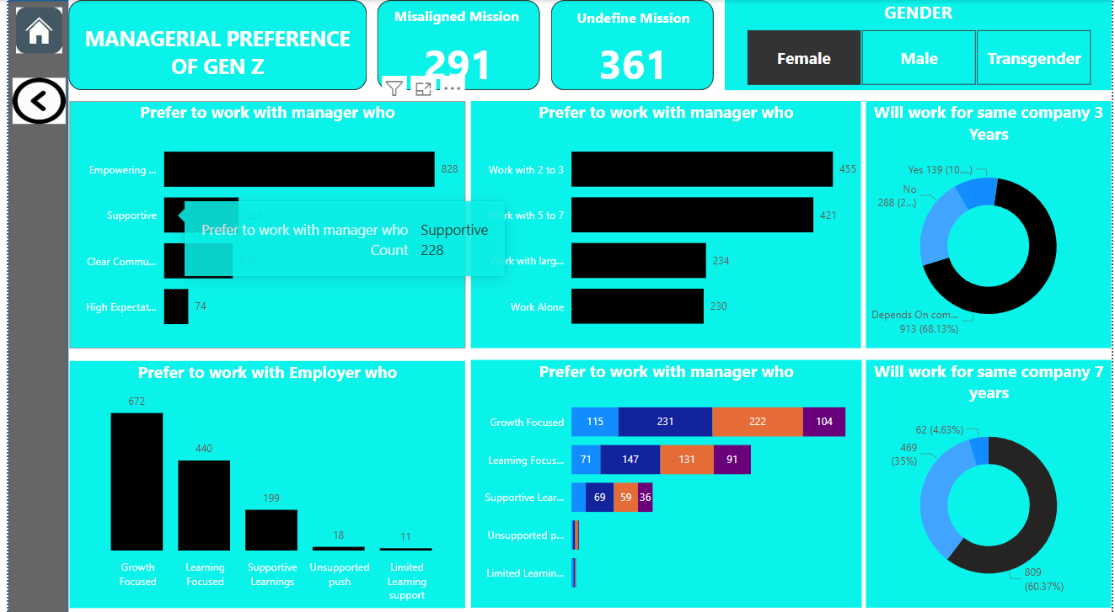

Slide 20
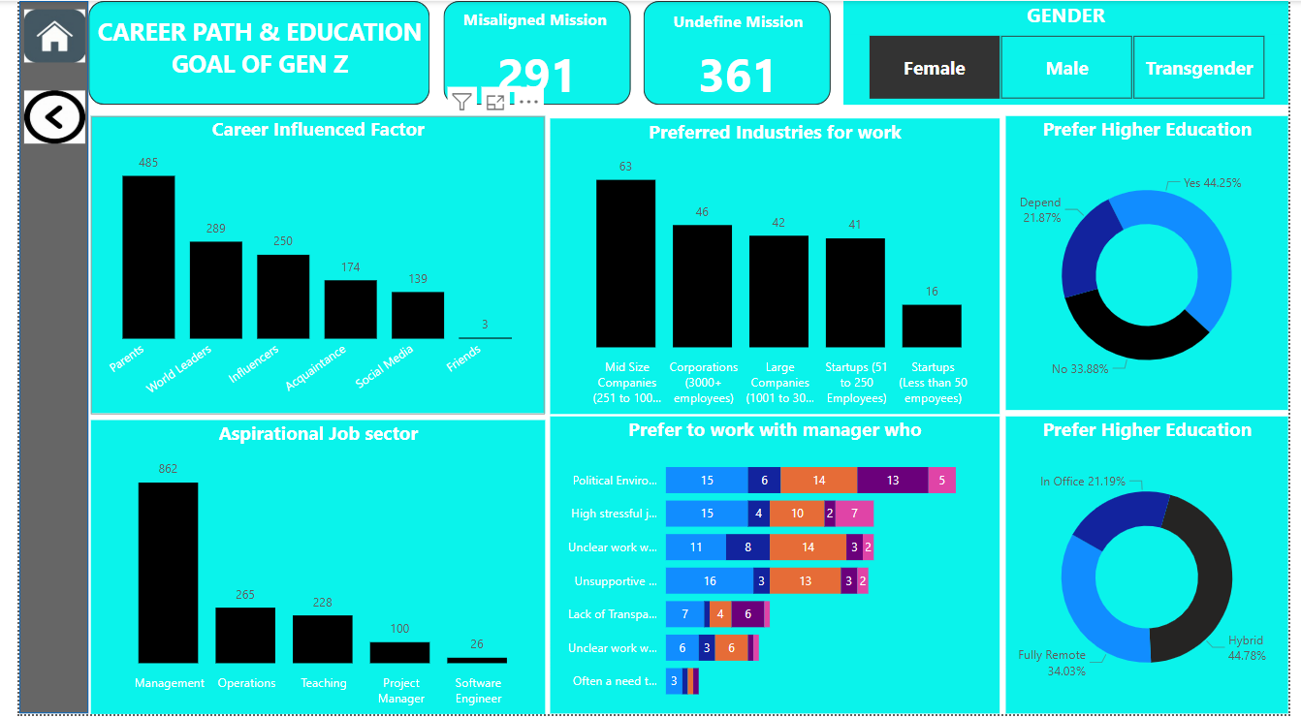

Slide 21
FINAL
PROJECT
REPORT

Slide 22
WORK ALIGNMENT OF GEN Z
Salary Expectations (5 Years’ Experience):
Highest expectations are between ₹91k–₹110k (308 responses) and >₹130k (302 responses)
Lower ranges like ₹50k–₹70k.
Salary Expectations (3 Years’ Experience, Misaligned Mission):
Majority of Gen Z with misaligned mission expect
₹41k–₹50k (368 responses)
₹31k–₹40k and ₹26k–₹30k also significant.

Slide 23
Managerial & Employer Preferences
Preferred Manager Traits:
Empowering (828), Supportive (228), Clear Communication (210).
Preferred Working Style:
Majority prefer working in teams of 2–3 (455) or 5–7 members (421).
Employer Attributes:
Growth-Focused (672) and Learning-Focused (440) employers are top preferences.
Retention Outlook:
Only 10.37% would stay 3 years; 60.37% might stay 7 years based on conditions.

Slide 24
Career Path & Education Goals
Influencing Factors:
Parents (485), World Leaders (289), and Influencers (250) are top career influencers.
Industry Preferences:
Mid-size companies and Corporations (3000+ employees) preferred.
Aspirational Job Sectors:
Management (862), Operations (265), and Teaching (228) are top career goals.
Education & Work Mode Preferences:
44.25% prefer higher education.
Hybrid work (44.78%) is most desired; 34.03% prefer fully remote roles.

Slide 25
THANK
YOU

